Slide 1
Course : Computational Physics
Effective Period : April 2022
Lecturer : Fabian S. Pramudya
Simulating Basic Resistive Circuits

Slide 2
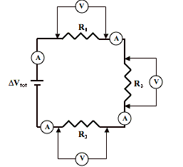
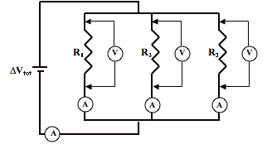
Objective and Outline
LO : Implement a computational simulation of basic electrical circuits using Python programming language
In this course we will be simulating power electronic circuits using Python. However, the Python part is not heavy. This course is ideal for students only with a basic knowledge of network theory and programming to get started with simulating simple power electronic circuits. The course contains a basic introduction to the Python Power Electronic (PPE) and describes how to use it to simulate simple rectifier (RLC) circuits.
In this session, we will start exploring a simulation concept using Open-Source Python Power Electronics
Download : https://www.pythonpowerelectronics.com/
Outline
Design Series and Parallel Resistive Circuits
Understanding simulation output graph

Slide 3
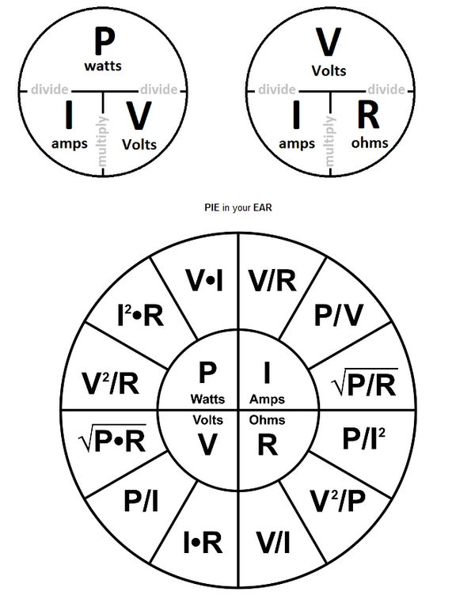
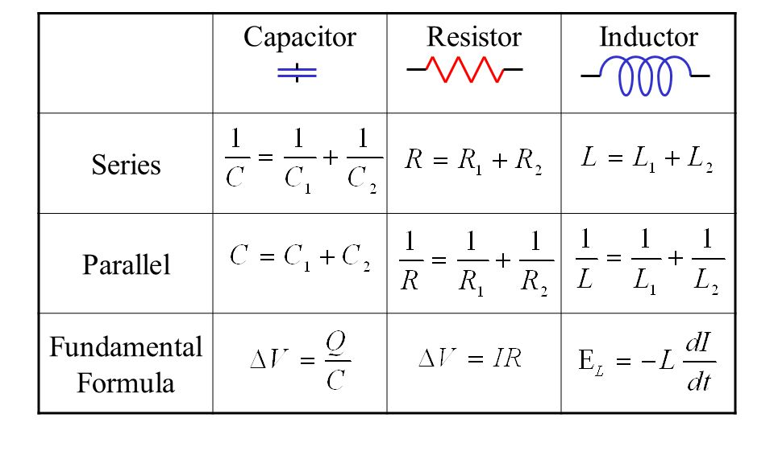
Simulating Basic Resistive Circuits (Ohm’s Law)
Today session will cover on how you can understand Ohm’s Law by simulation both series and parallel circuit, and calculate:
Total Current
Current through each Resistors
Voltage at the end or between Resistors
equation that describes relationship of circuit type and components
Ohm's law states that the current through a conductor between two points is directly proportional to the voltage across the two points.
Introducing the constant of proportionality, the resistance, arrives at the usual mathematical equation that describes this relationship

Slide 4
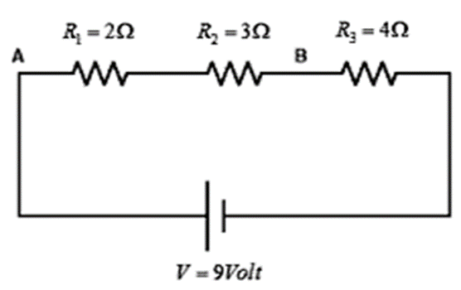
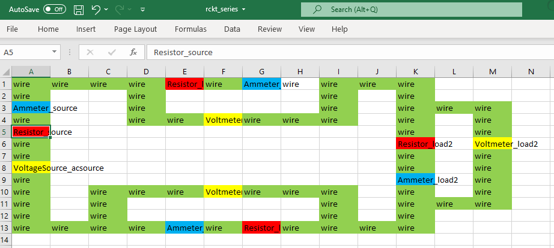
Simulating Resistive Circuits (Series)
Open MS Excel and recreate the circuit design
Rules: ComponentType_ComponentName and its case sensitive.
Save in basic .CSV file → e.g D:\...\simulations\basic_resistor_example\resistor_seri.csv (this is your WORKING DIRECTORY)
Webserver launch reminder!
Activate ppe environment
Go to manage.py folder directory (launch file)
If the structured database is already created, run the webserver by python manage.py runserver
Copy http://127.0.0.1:8000/ (or other URL) and run in your browser
Creating simulation
Run the PPE webserver
Create new simulation ‘R Circuit Series’, add your working directory file.
Solve the warning if there is any, save first, and you can edit later when you need it.

Slide 5
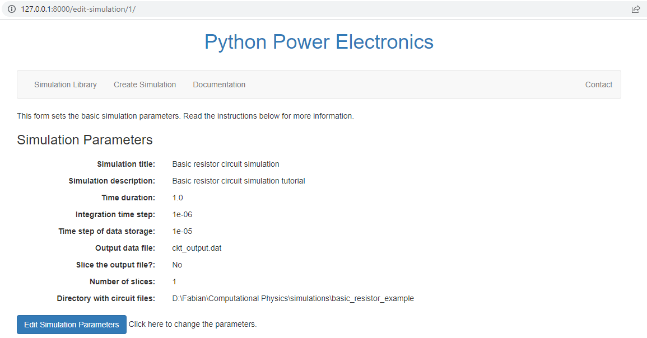

Slide 6

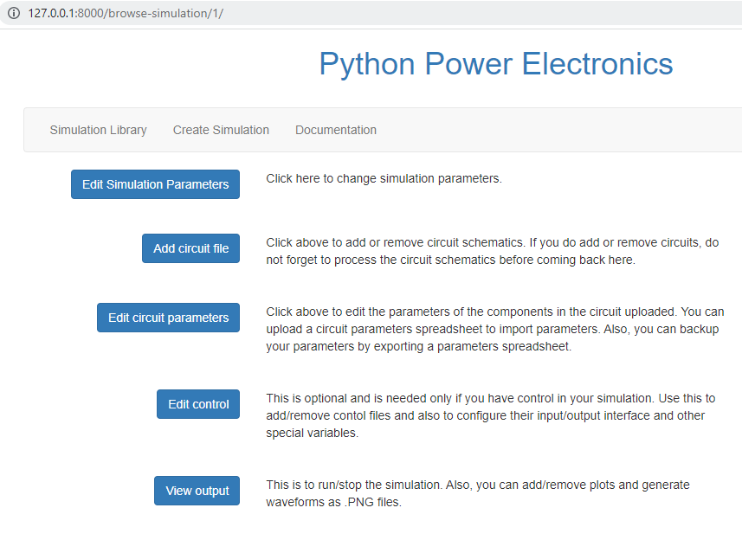
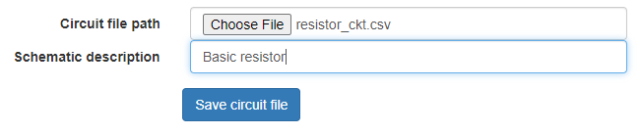
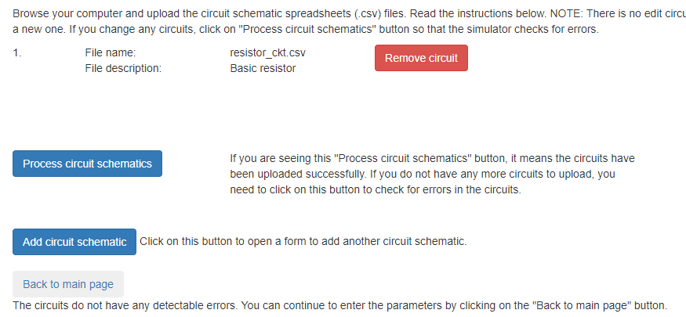
(*) resistor_ser
Adding minimalistic circuit simulation
Check is the testfile is created in the WORKING FOLDER
Open and understand the .CSV file structure using word editor
Go to Simulation Library → Load the Simulation → Back to Main Page
Add circuit file → select file → safe circuit file → process circuit schematic
If error, update the .CSV file → process circuit schematic. No need to reupload
Then → Back to main page

Slide 7
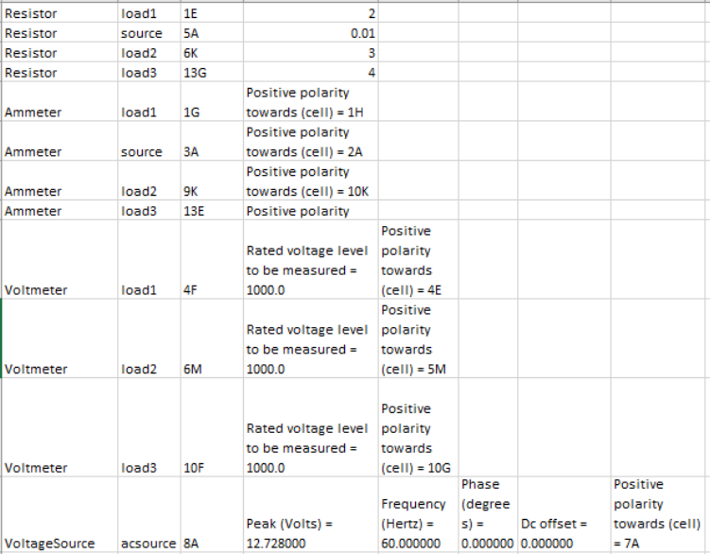


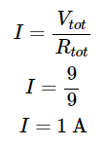
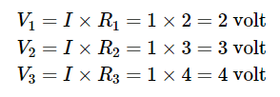
Simulating Resistive Circuits (Series)
Edit Circuit Parameter
Click Edit circuit parameter → Edit parameter and change according to the parameter here.
We tried to simulate the numbers and component behaviour

Slide 8
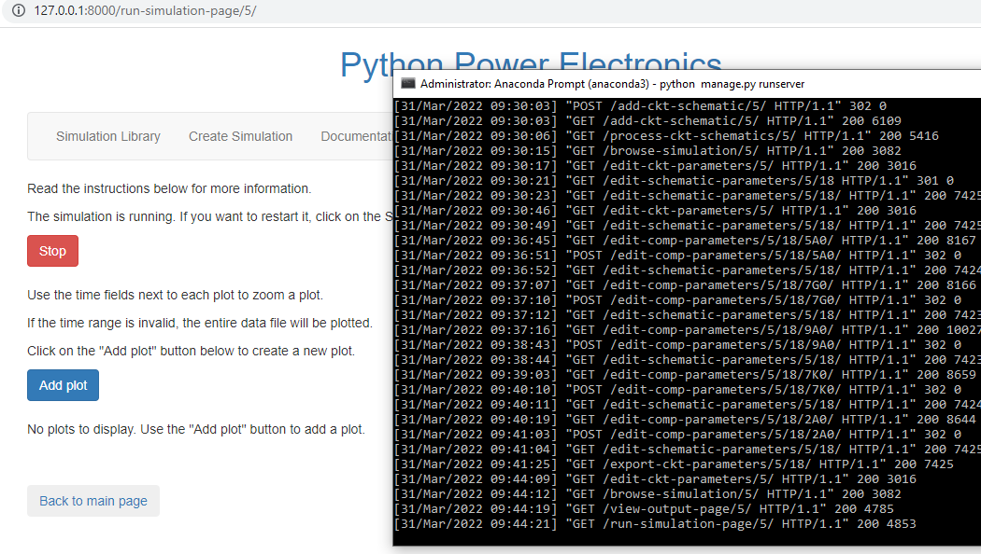
Simulating Resistive Circuits (Series)
Run Simulation
Go back to the main menu → Click View output
Check if there is any error on the anaconda prompt
Run the simulation → add Plot

Slide 9
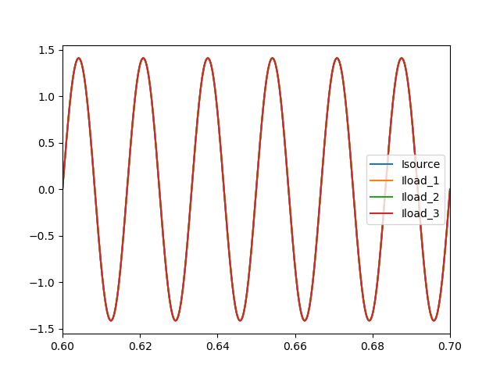
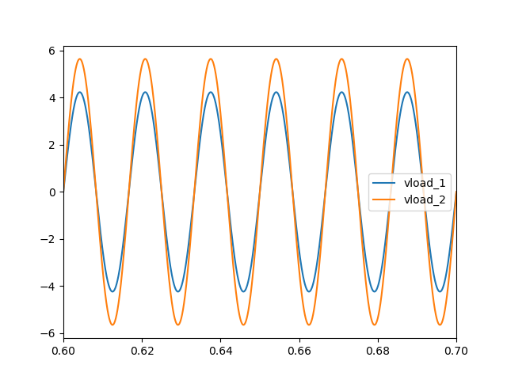
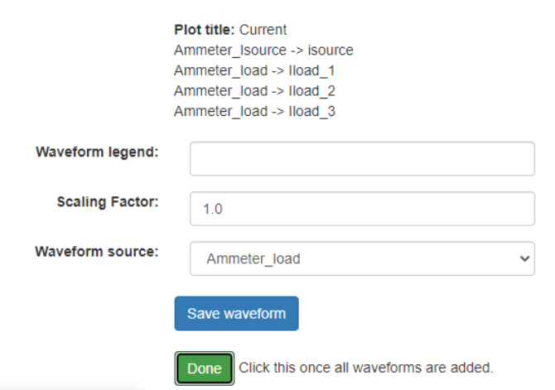
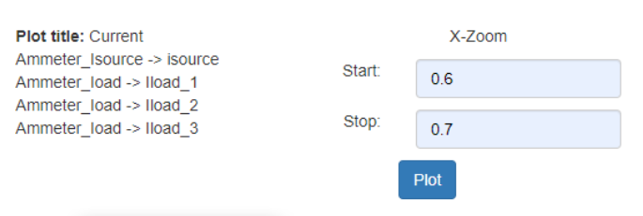
Simulating Resistive Circuits (Series)
Plot Simulation
Add Plot → input name of the plot ‘Current’
Input waveform legend ‘isource’
Choose Waveform source is ‘Ammeter_source’ → Save Waveform
Do these steps for the rest of the load – ammeter → Done
Do the same steps for the ‘Voltage’ plot → Done
Input X-zoom (optional) → Click Plot on each of the graph
‘Voltage’
Vload_1 – Voltmeter_load1
Vload_2 – Voltmeter_load2
Vload_3 – Voltmeter_load3

Slide 10
Simulating Resistive Circuits (Parallel)
Edit Circuit Parameter
Click Edit circuit parameter → Edit parameter and change according to the parameter here.
We tried to simulate the numbers and component behaviour

Slide 11
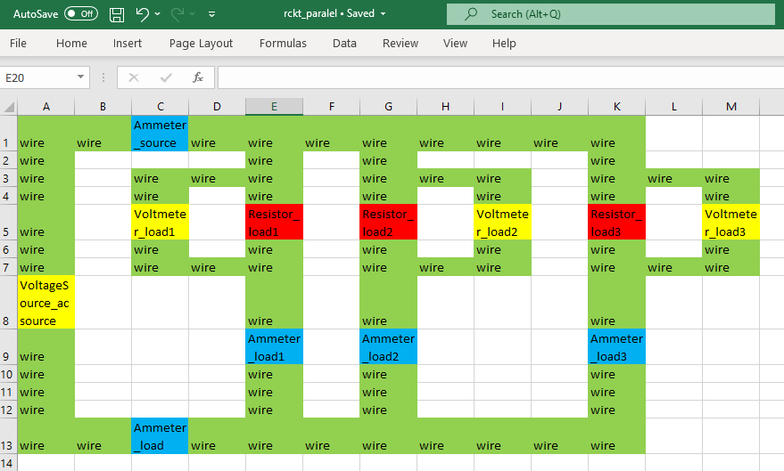
Simulating Resistive Circuits (Parallel)
Open MS Excel and recreate the circuit design
Rules: ComponentType_ComponentName and its case sensitive.
Save in basic .CSV file → D:\...\simulations\basic_resistor_example\resistor_par.csv (this is your WORKING DIRECTORY)
Webserver launch reminder!
Activate ppe environment
Go to manage.py folder directory (launch file)
If the structured database is already created, run the webserver by python manage.py runserver
Copy http://127.0.0.1:8000/ (or other URL) and run in your browser
Creating simulation
Run the PPE webserver
Create new simulation ‘R Circuit Series’, add your working directory file.
Solve the warning if there is any, save first, and you can edit later when you need it.

Slide 13
Adding minimalistic circuit simulation
Check is the testfile is created in the WORKING FOLDER
Open and understand the .CSV file structure using word editor
Go to Simulation Library → Load the Simulation → Back to Main Page
Add circuit file → select file → safe circuit file → process circuit schematic
If error, update the .CSV file → process circuit schematic. No need to reupload
Then → Back to main page
(*) resistor_par

Slide 14
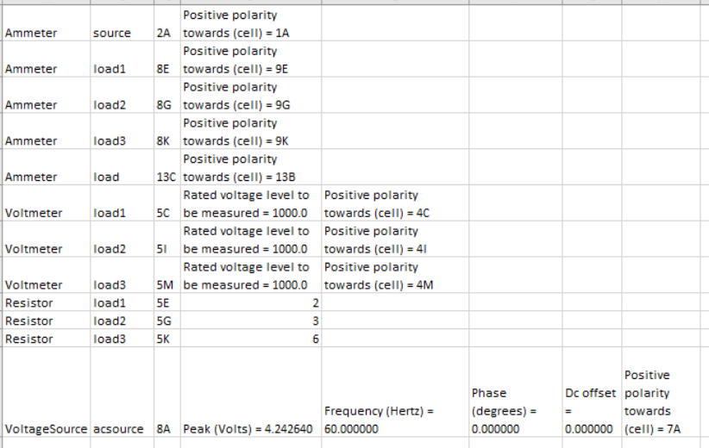
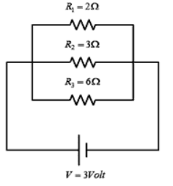
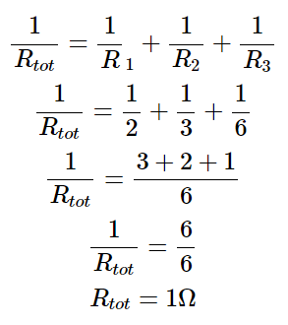
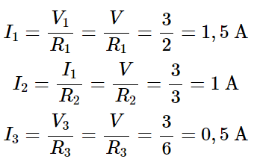

Simulating Resistive Circuits (Parallel)
Edit Circuit Parameter
Click Edit circuit parameter → Edit parameter and change according to the parameter here.
We tried to simulate the numbers and component behaviour

Slide 15
Simulating Resistive Circuits (Parallel)
Run Simulation
Go back to the main menu → Click View output
Check if there is any error on the anaconda prompt
Run the simulation → add Plot

Slide 16
Simulating Resistive Circuits (Parallel)
Plot Simulation
Add Plot → input name of the plot ‘Current’
Input waveform legend ‘isource’
Choose Waveform source is ‘Ammeter_source’ → Save Waveform
Do these steps for the rest of the load – ammeter → Done
Do the same steps for the ‘Voltage’ plot → Done
Input X-zoom (optional) → Click Plot on each of the graph
‘Voltage’
Vload_1 – Voltmeter_load1
Vload_2 – Voltmeter_load2
Vload_3 – Voltmeter_load3

Slide 17
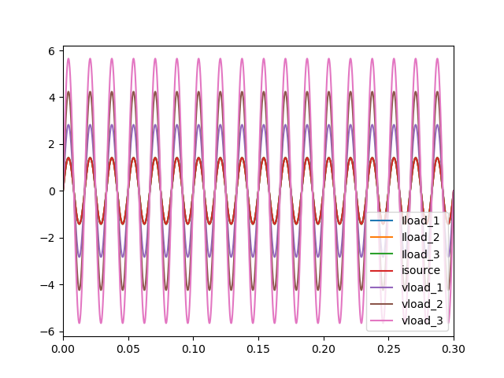
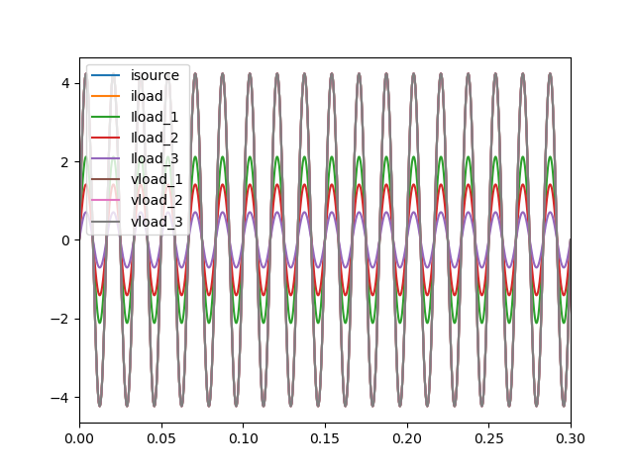
Discussion
We have simulated the Series and parallel resistive circuit. The graphs represent how Ohm’s law are applied in AC Source. Can you elaborate more on how the graphs are different? You can refer to the text-book/ supporting materials

